Slide 1
Welcome to the House Championship 2023-24

Slide 2
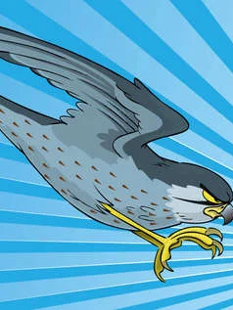
Who will lift the trophy this year?

Slide 3
Will the Kestrels or Bears write their own line in the House History books…?
2022-23 Wilbraham Wolves
2021-22 Dorfold Dolphins
2020 – 21 Dorfold Dolphins
2019 – 2020 Wilbraham Wolves

Slide 4
Once again, everything you do every day, every lesson, matters to your House...
The Big Three:
House Stars
Making the 60 Matter
Attendance

Slide 5
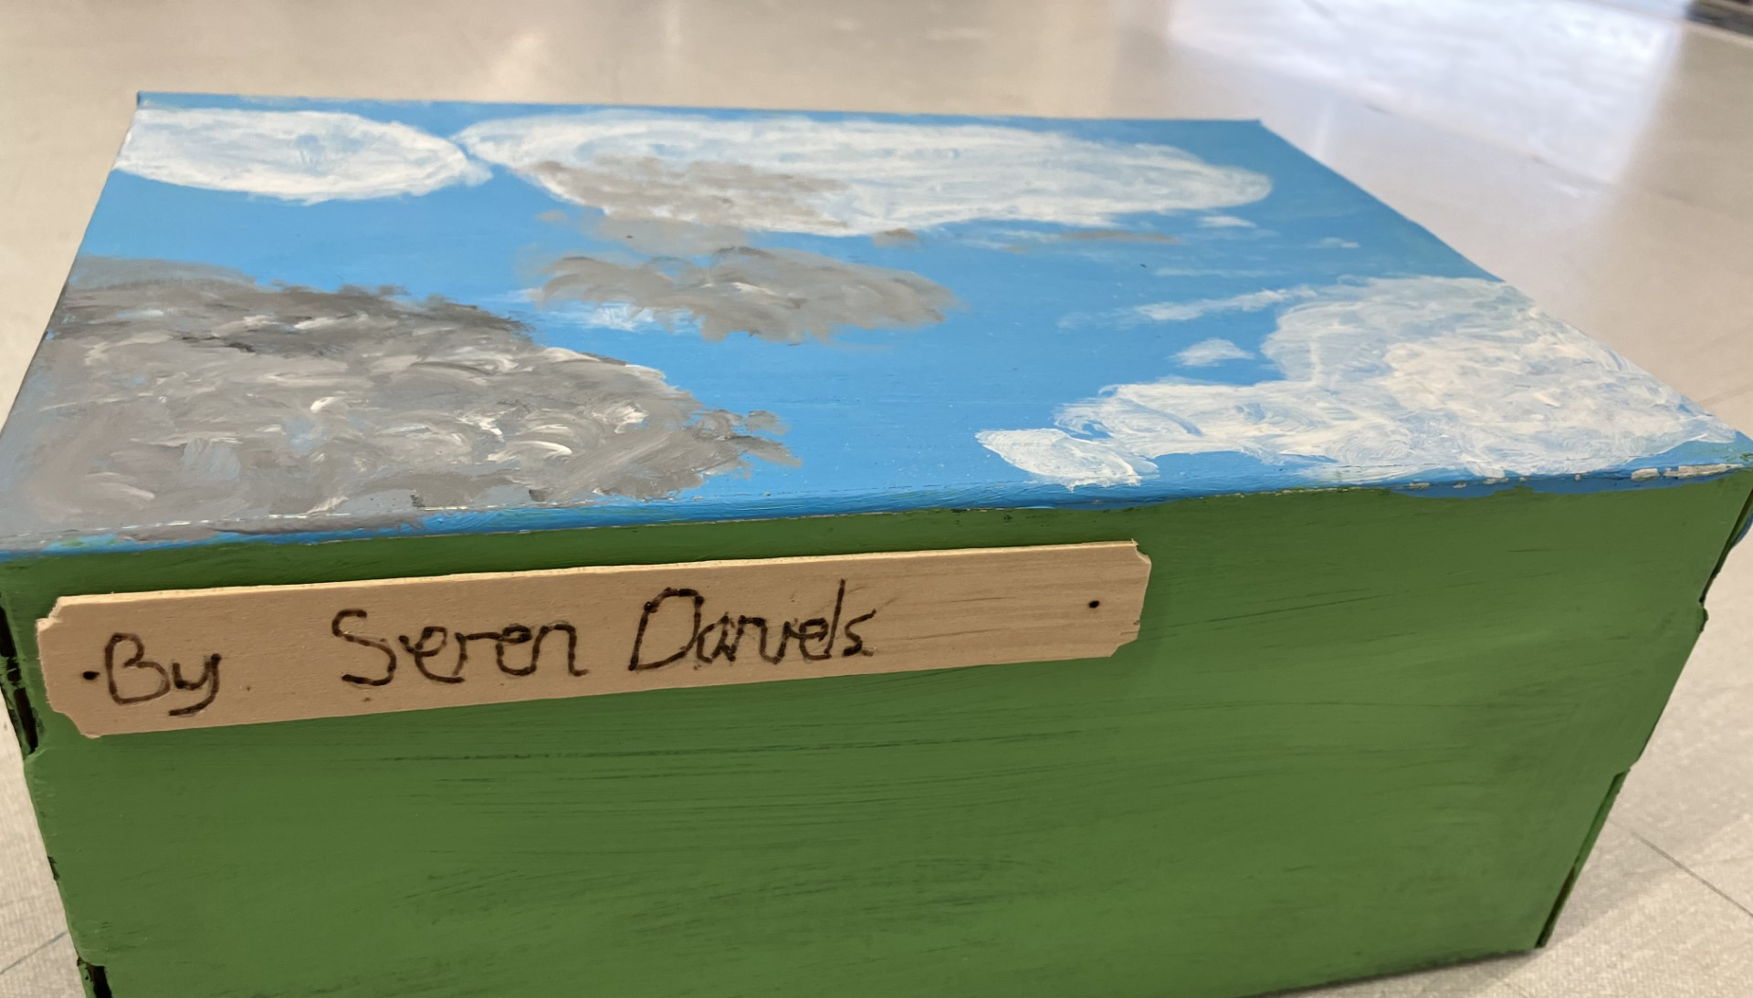
Competition Alert
Year 7 House Art Competition – entries to Mrs Jennings in the Art Department by Monday 9th

Slide 6
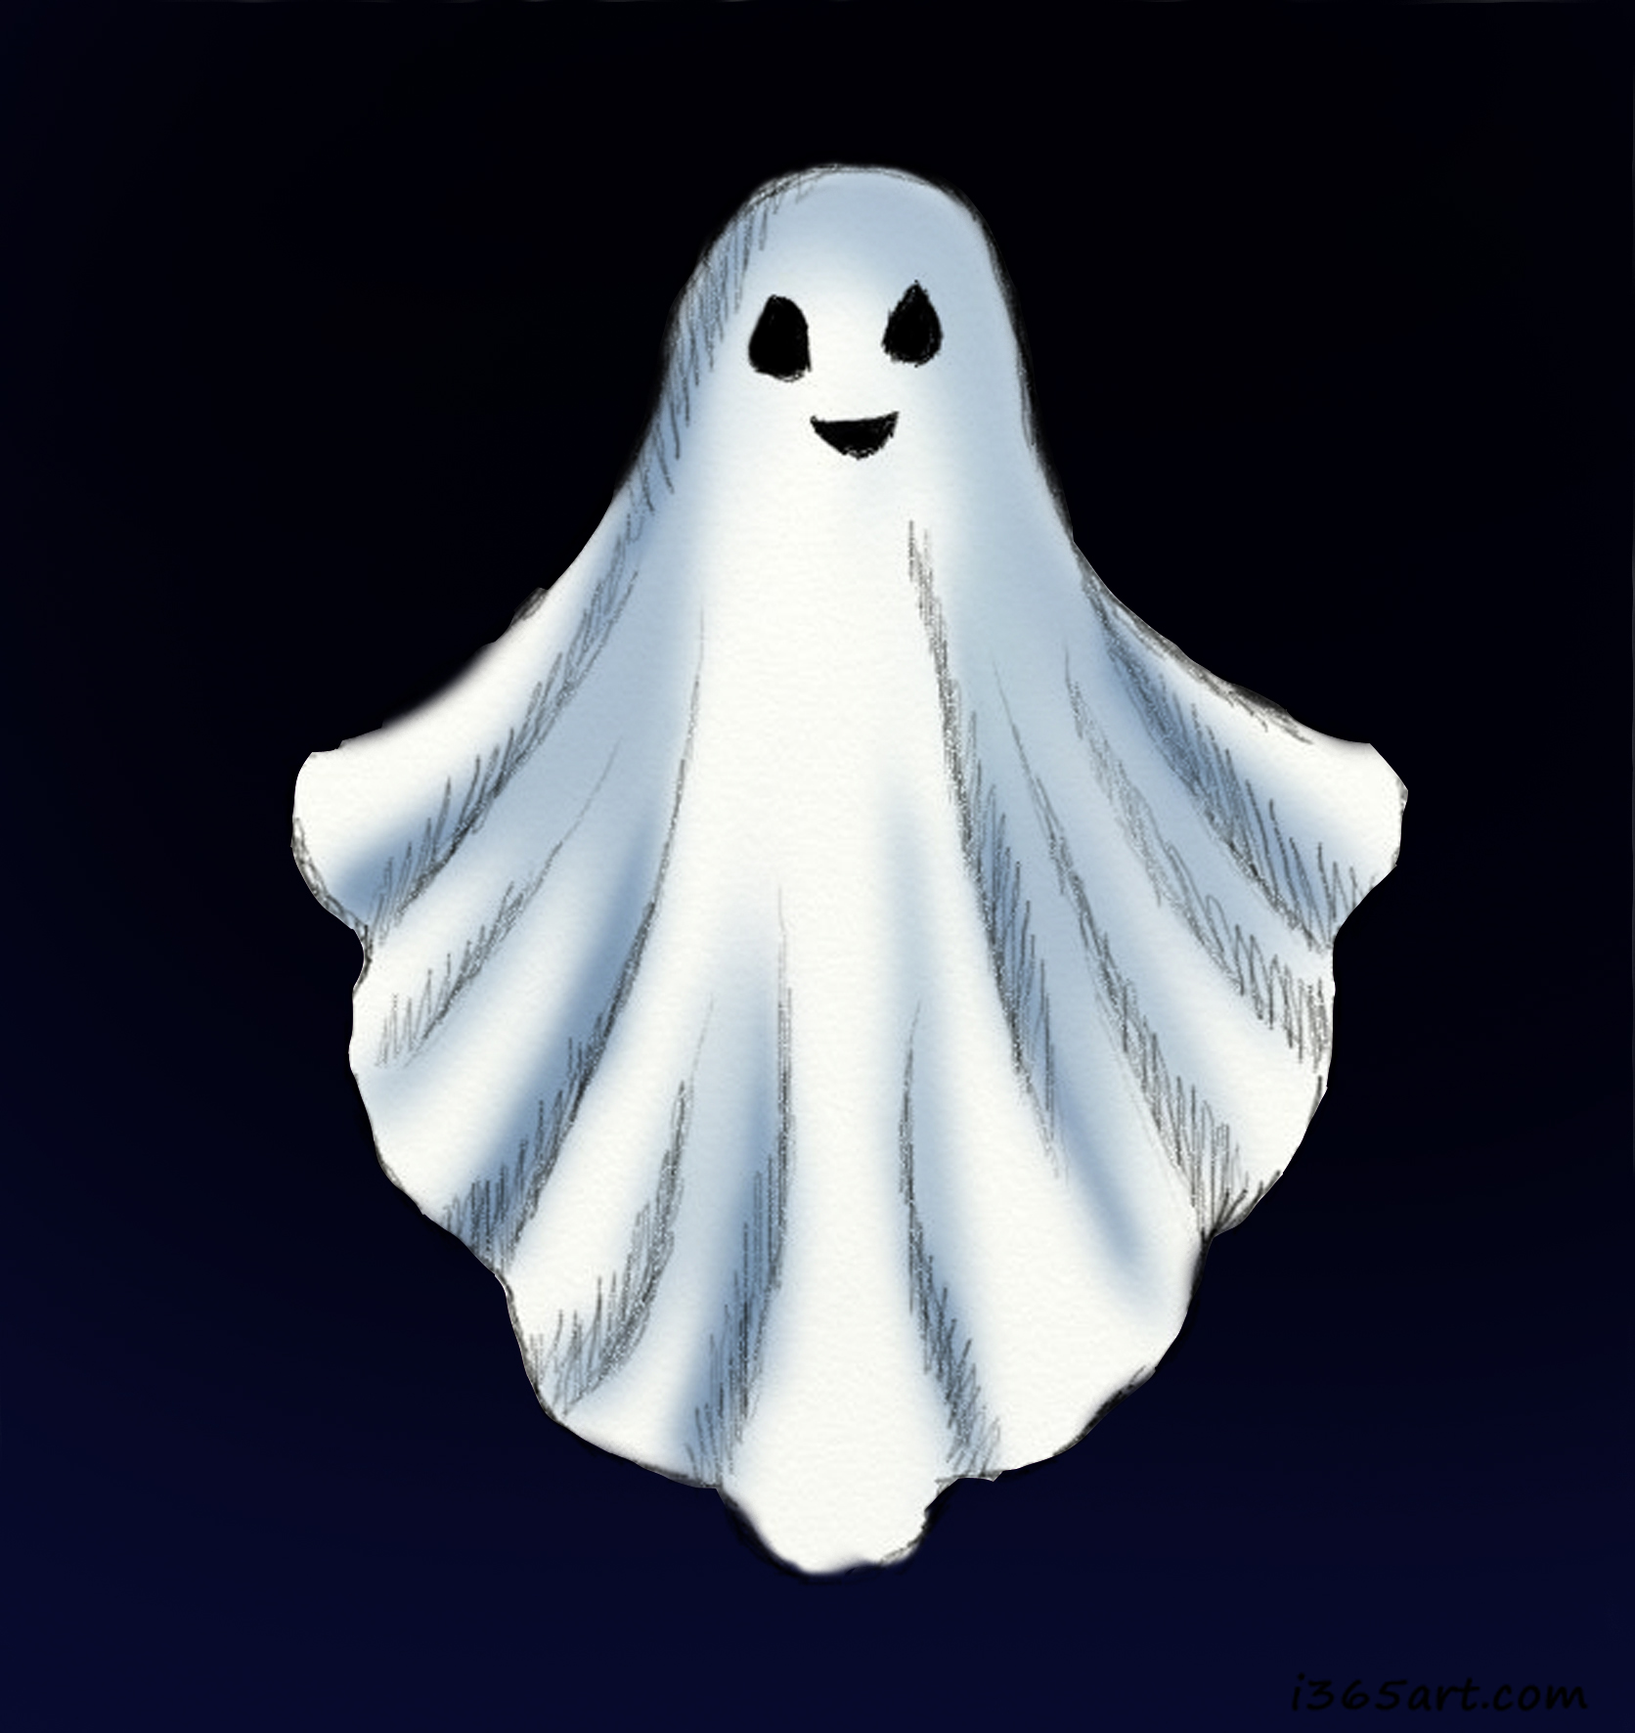
House Competition Alert – Creative Writing
Write a short piece of Creative Writing (a story, a poem, a description etc) on a Halloween or autumnal theme
Entries will be judged by Headteacher Mr Harrison and Deputy Head Mrs Edwards
Please give your entries to your form tutor by Thursday 19th October

Slide 7
House Leadership is vital
We can’t do this without you so get involved…

Slide 8
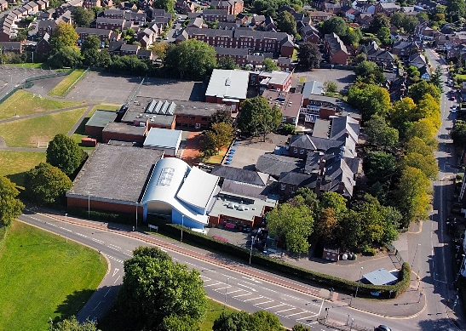
Sort your team for the Malbank House Relay…
One runner from each year group to face off against the other Houses in a race for glory…
Sign up with your Head of House

