Slide 1
House Championship 2023-24
Season 5: Weeks 1 - 3

Slide 2
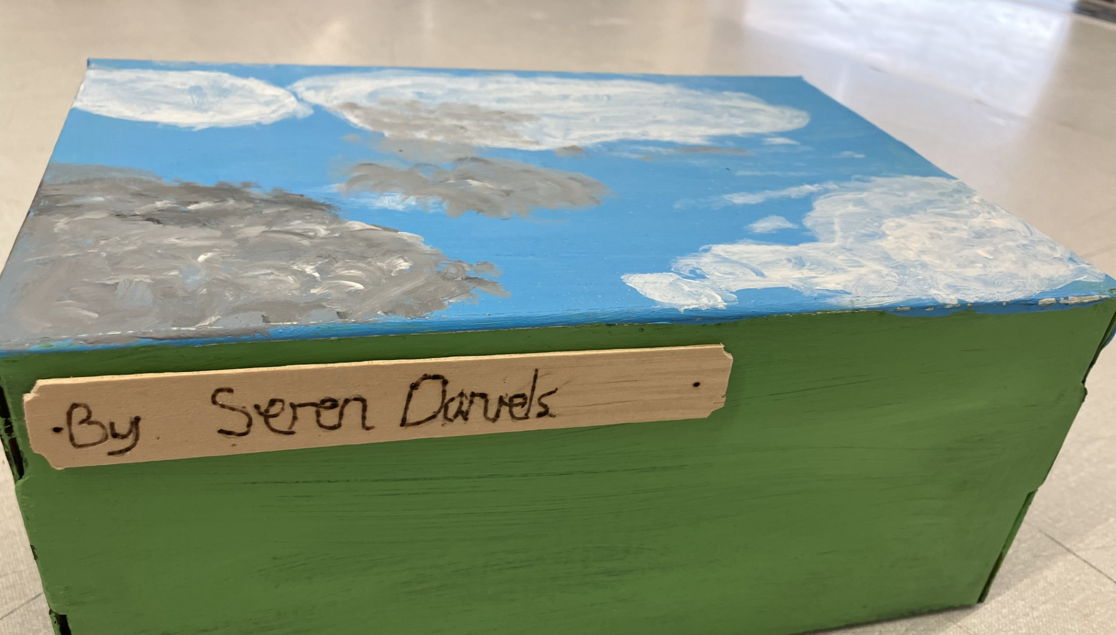
Competition Alert
Year 7 House Art Competition – entries to Mrs Jennings in the Art Department by Monday 9th

Slide 3
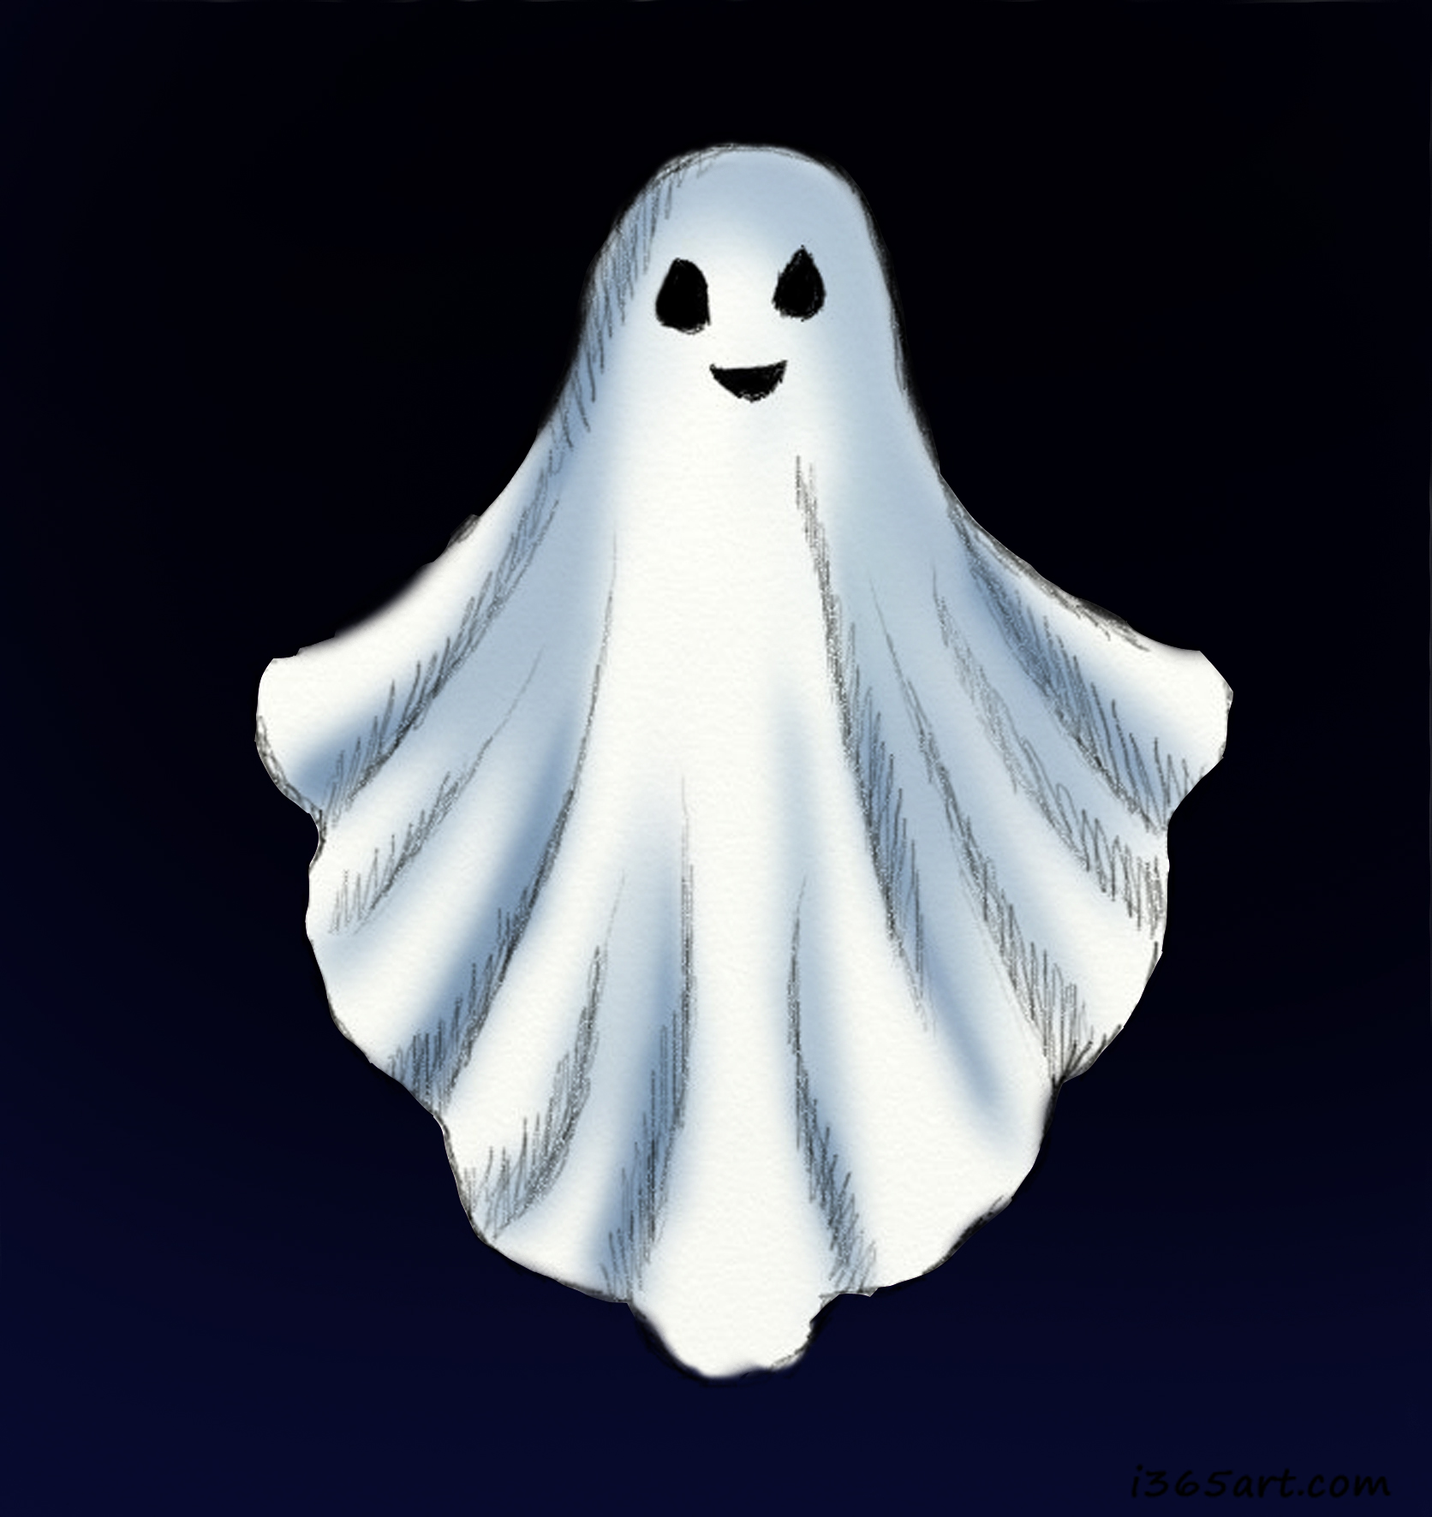
House Competition Alert – Creative Writing
Write a short piece of Creative Writing (a story, a poem, a description etc) on a Halloween or autumnal theme
Entries will be judged by Headteacher Mr Harrison and Deputy Head Mrs Edwards
Please give your entries to your form tutor by Thursday 19th October

Slide 4
Lets see the score from the first three weeks - who will set the pace this year?

Slide 5
Score from the first three weeks are made up from the Big 3...
The Big Three:
House Stars
Making the 60 Matter
Attendance

Slide 6
House Stars Week 1-3
Bears 117 = 9 point
Dorfold 122 = 12 points
Kent 107 = 6 points
Wilbraham 105 = 3 points

Slide 7
Making the 60 Matter(lesson Monitor 1s & 2s)Weeks 1-3
Brereton: 25983 = 6 points
Dorfold: 25258 = 3 points
Kent: 25941 = 9 point
Wilbraham: 26279 = 12 points

Slide 8
Attendance Cup Weeks 1-3
Brereton: = 3 points
Dorfold: = 12 points
Kent: = 6 points
Wilbraham: = 9 points

Slide 9
21
24
18
27

Slide 10
House Leadership is vital
We can’t do this without you so get involved…

Slide 11
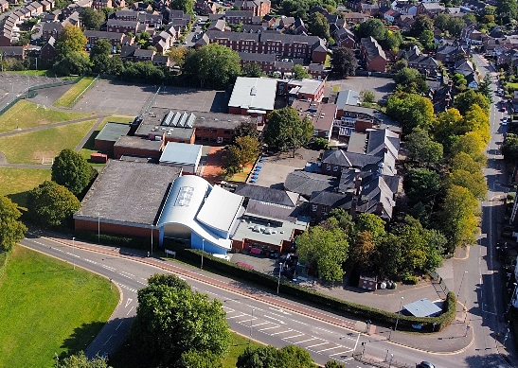
Sort your team for the Malbank House Relay…
One runner from each year group to face off against the other Houses in a race for glory…
Sign up with your Head of House

